Slide 2
Recap

Slide 3
To Discuss…
What can you remember from the course so far?

Slide 4
The Task of Reading
Reading involves interpreting
Interpreting is dangerous and difficult
The point of reading the bible is the pursuit of Practical Wisdom

Slide 5
Reader
Text
Author

Slide 6
Reader

Slide 7
Humility
Prayer
Divine Transcendence

Slide 8
Honesty
Our own bias, prejudice and prior position
Need to read across cultures and through time
Most of our bias is hidden from view

Slide 9
Openness
Hearing the voice that changes how we think and act

Slide 10
Text

Slide 11
The Bible is a Library
One Big Story
Lots of Different Stories:
A Great Conversation

Slide 12
Author

Slide 13
Finding the Word in the words
The Jesus Filter

Slide 14
The Jesus Filter
God stands with the victims. He moves way from the centre towards the margins

Slide 15
The Jesus Filter
God desires peace and welcomes all into his Kingdom of Peace

Slide 16
The Jesus Filter
God is a god of Life and Love

Slide 17
Eternal Life and Salvation

Slide 18
To Discuss…
What is salvation?
What must we do to be saved?
What is eternal life?
Who is saved?
What is hell? Does it exist?

Slide 19
Eternal Life and Salvation
Reader

Slide 20
Humility
Prayer
The limits of language:
Analogy and Metaphor

Slide 21
Activity
Honesty

Slide 22
Openness
Are we open to new and different ways of thinking about eternal life and salvation or are our views totally fixed?
What might get in the way of us being open to hear the ‘strange voice’ in the bible?

Slide 23
Eternal Life and Salvation
Text

Slide 24
Activity…
What is salvation and how is life after death understood?

Slide 25
The Old Testament
Salvation is about this world
Most of the OT suggests life simply ends at death (bar Daniel)

Slide 26
The Apocrypha
Voice 1:
Physical Resurrection
Voice 2:
The Immortal Soul

Slide 27
The New Testament
Voice 1:
A Physical Resurrection at final judgement
Voice 2:
Leave the body and go to be with Jesus
Voice 3:
A mix of the two other voices

Slide 28
Activity…
How are we saved and who is saved?

Slide 29
Voice 1:
We are saved by ‘faith’
Voice 2:
Faith is showed through action
Voice 3:
Loving the poor is all that matters / The poor inherit the Kingdom and the rich do not

Slide 30
Voice 4:
All will be saved.
Voice 5:
Something about childbearing?!

Slide 31
Eternal Life and Salvation
Author

Slide 32
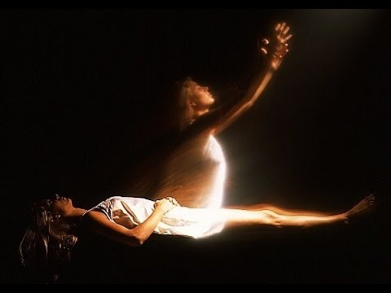

Slide 35
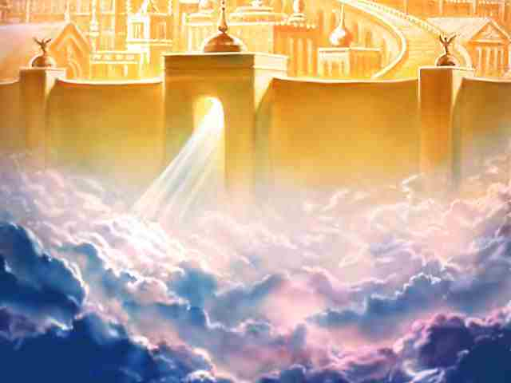

Slide 36
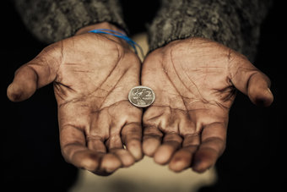

Slide 38
To Conclude…

